Slide 1

Demographic Dashboard for Housing Data Analysis
BY
SAHITHI BIKUMALLA

Slide 2

Introduction
Today's world demands data-driven decision-making.
Introducing a comprehensive demographic dashboard for housing data examination.
Utilizes Streamlit for interactive web applications.
Features include: median age, total rooms/bedrooms, population, income, property value.

Slide 3

Methodology.
Data Loading and Preprocessing:
Utilizing Pandas for data manipulation.
Filling missing values with mean values.
Design and Implementation of Dashboard:
Built with Streamlit for flexibility and ease of use.
Multiple visualizations: scatter plots, geographical distributions, heatmaps, histograms.
User Involvement and Exploration:
Users can dynamically explore data through various visualizations.
Optimization and Performance:
Streamlit's caching techniques improve performance

Slide 4
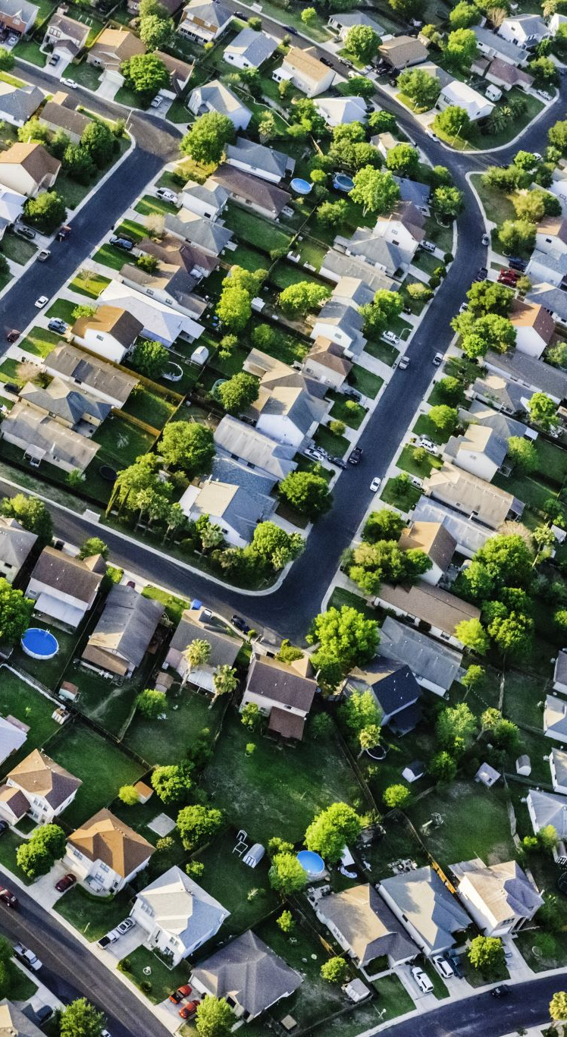
Results:
Geographic Distribution:
Predominantly towards the western region, possibly California.
Median Age:
Reflects mix of older and younger dwelling units.
Room and Bedroom Counts:
Diversity indicates various household configurations.
Population and Household Features:
Suggest highly inhabited urban or suburban areas.
Median Dwelling Value and Income:
Wide range reflects socioeconomic landscape.

Slide 5

Future Plans.
Feature Engineering:
Extracting more informative features.
Predictive Modelling:
Integrating ML models for forecasting and price prediction.
Enhanced User Experience:
Adding interactive filtering and customization tools.
Geospatial Analysis:
Incorporating interactive maps for deeper insights.
External Data Sources:
Integrating environmental or socioeconomic variables.
Collaboration Features:
User authentication, version control, commenting.
Performance and Scalability:
Continuous optimization for flawless user experience.

Slide 6

Conclusion
Utilizing Data-driven Insights:
Introduction of demographic dashboard enhances decision-making.
Features and Benefits:
Interactive visualizations, geospatial analysis, future plans.
Potential Users:
Researchers, politicians, urban planners, real estate professionals.
Facilitating Evidence-based Decision-making:
Promoting favorable results in housing markets and beyond.
Future Potential:
Vital tool for handling housing and urban development challenges.

